Slide 1


Salary prediction Project - I
Author :
Anand Veerarahavan

Slide 2


Introduction
Objective:
To thoroughly understand and research the problem statement.
To gather the dataset related to the problem.
To apply the best suited machine learning algorithms on the dataset.
To convert the problem statement into a viable business solution.
To visualize the data obtained after training the model on the dataset.

Slide 3


Contents :
Problem statements
Data set exploration and analysis
Algorithm explanations
Source code
Execution
Data Visualization
Inference

Slide 4


Problem statement
Mark has set up a new startup software company and prepares to hire candidates for the different positions. Although he has experience in management, he finds it difficult to predict the salary for each role.
Each position requires a different pay slab and Mark gets an idea to hire a machine learning engineer to estimate a model which can help him choose the salary for his employees and also to be aware of the market trends. The first interviewee walks in and quotes a salary which Mark finds intriguing. He turns to the model to help him predict if the interviewee is telling the truth.

Slide 5

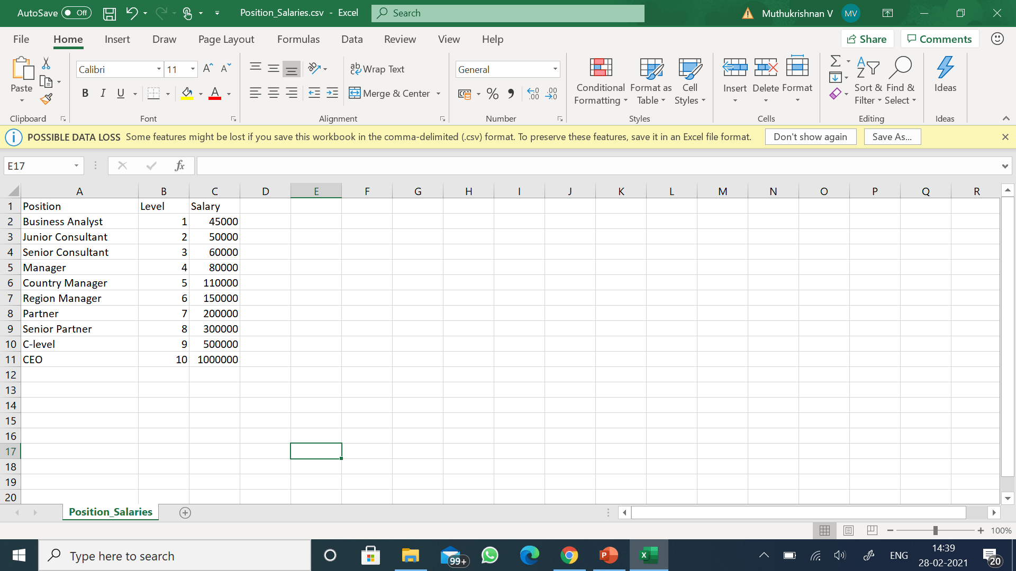
DATASET
Mark provides the dataset that contains salary details of different employees at different positions in a similar company.

Slide 6

Dataset exploration
In order to understand the data better , we need to prepare the data.
Data preparation is one of the first steps to explore the dataset and find the correlations between the parameters.
This step is called as
data pre-processing.

Slide 7


Data preprocessing
Importing the libraries
Importing the dataset
Taking care of Missing data
Encoding Categorical data

Slide 8

Importing the libraries
The first step of the data preprocessing is to import the libraries.
To work with arrays , to perform numerical operations and to plot graphs we need to import libraries.
Importing libraries is an essential step of data pre-processing.
NumPy is a Python library used for working with arrays. It also has functions for working in domain of linear algebra, Fourier transform, and matrices.
Pandas is a software library written for the Python programming language for data manipulation and analysis. In particular, it offers data structures and operations for manipulating numerical tables and time series.
Matplotlib is a comprehensive library for creating static, animated, and interactive visualizations in Python.

Slide 9

Code to import libraries
Numpy
import numpy as np
Pandas
import pandas as pd
Matplotlib
import matlplotlib.pyplot as plt

Slide 10

Importing the dataset
Here we define the dependent and independent variables of the model.
As we know that we need to predict the salary for different position in a company, we can easily conclude that the dataset that salary is a dependent variable and position is a independent variable(feature).
The code :
dataset = pd.read_csv(‘Position_Salaries.csv)
X= dataset.iloc[: ,1 : -1].values
y = dataset.iloc[: , -1].values
We read the file “Position_Salaries.csv” and set the value of X to the second column and y to the last column

Slide 11

Taking care of missing data
We need to replace the missing values in the dataset by filling in the average or by looking at the value similar or equal to it inside the dataset
To do this , we need SimpleImputer from sklearn library.
We also use LabelEncoder technique on the data
Code:
from sklearn.impute import SimpleImputer
imputer = SimpleImputer(missing_values = np.nan, strategy = ‘mean’)
imputer.fit(X[:,1:-1])

Slide 12

Encoding categorical data
For encoding the data there are a lot of encoders, the one we are going to use in our project is OneHotEncoder to encode the categorical data.
Code :
from sklearn.compose import ColumnTransformer
from sklearn.preprocessing import OnehotEncoder
ct = ColumnTransformer(transformer=[(‘encoder’, OneHotEncoder(),[0])],remainder =‘passthrough’)
X =np.array(ct.fit_transform(X))
from sklearn.preprocessing import LabelEncoder
le= LabelEncoder()
y= le.fit_transform(y)

Slide 13

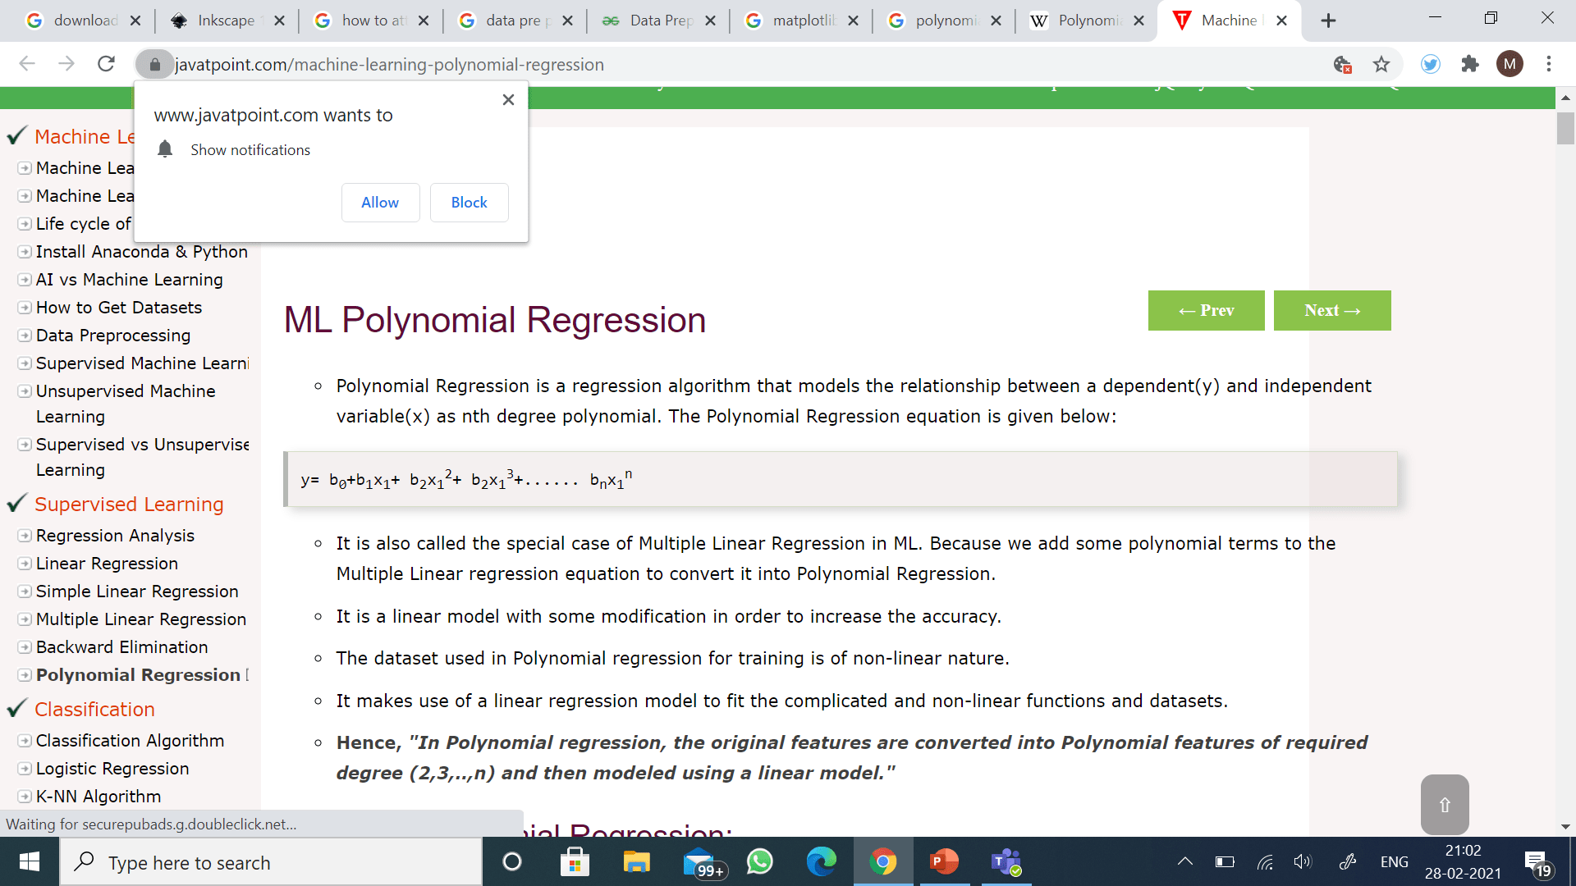
Polynomial regression(Algorithm explained)
Polynomial Regression is a regression algorithm that models the relationship between a dependent(y) and independent variable(x) as nth degree polynomial.
If we apply a linear model on a linear dataset, then it provides us a good result as we have seen in Simple Linear Regression, but if we apply the same model without any modification on a non-linear dataset, then it will produce a drastic output. Due to which loss function will increase, the error rate will be high, and accuracy will be decreased.
So for such cases, where data points are arranged in a non-linear fashion, we need the Polynomial Regression model. We can understand it in a better way using the below comparison diagram of the linear dataset and non-linear dataset.

Slide 14

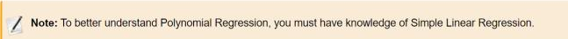
Implementation of Polynomial Regression
The Simple and Multiple Linear equations are also Polynomial equations with a single degree, and the Polynomial regression equation is Linear equation with the nth degree. So if we add a degree to our linear equations, then it will be converted into Polynomial Linear equations.
Here we will implement the Polynomial Regression using Python. We will understand it by comparing Polynomial Regression model with the Simple Linear Regression model.
Here, we will build the Linear regression model as well as Polynomial Regression to see the results between the predictions. And Linear regression model is for reference.

Slide 15


Building the Linear regression model
Now, we will build and fit the Linear regression model to the dataset. In building polynomial regression, we will take the Linear regression model as reference and compare both the results. The code is given below:
Code:
from sklearn.linear_model import LinearRegression
lin_regs= LinearRegression()
lin_regs.fit(x,y)
In the above code, we have created the Simple Linear model using lin_regs object of LinearRegression class and fitted it to the dataset variables (x and y).
Output:
Out[5]: LinearRegression(copy_X=True, fit_intercept=True, n_jobs=None, normalize=False)

Slide 16

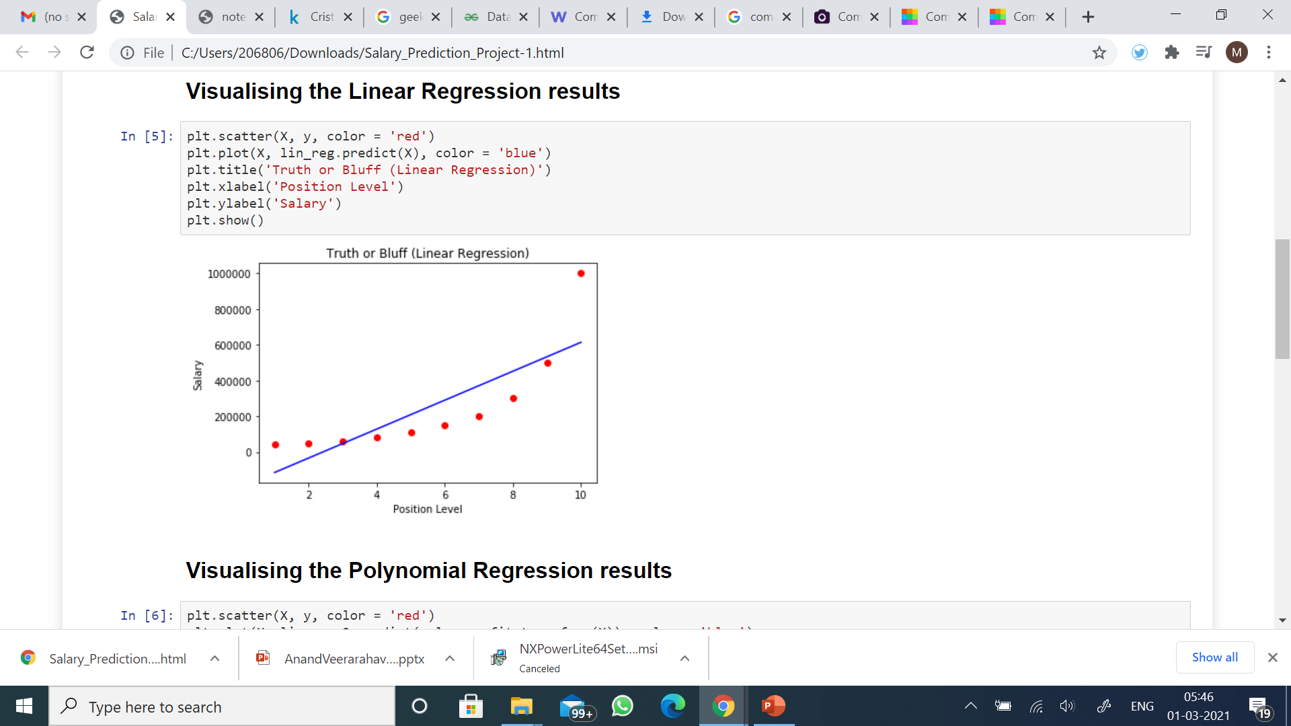
Visualizing the result for Linear regression
Now we will visualize the result for Linear regression model as we did in Simple Linear Regression. Below is the code for it:
Code :
mtp.scatter(x,y,color="blue")
mtp.plot(x,lin_regs.predict(x), color="red")
mtp.title("Bluff detection model(Linear Regression)")
mtp.xlabel("Position Levels")
mtp.ylabel("Salary")
mtp.show()

Slide 17

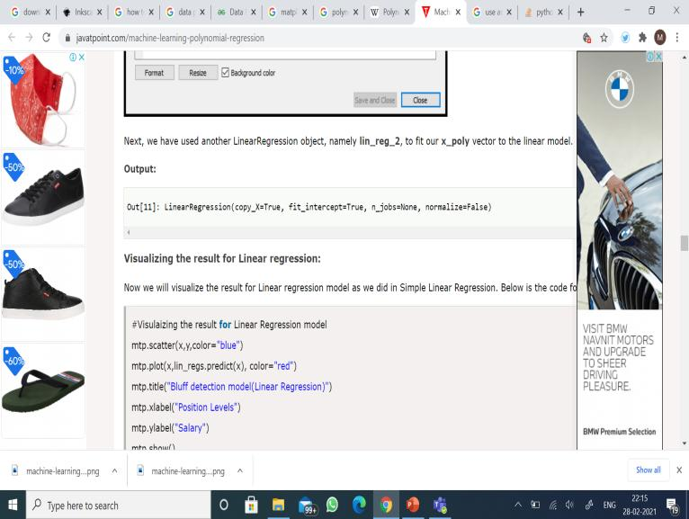
Building the Polynomial regression model
Now we will build the Polynomial Regression model, but it will be a little different from the Simple Linear model. Because here we will use PolynomialFeatures class of preprocessing library. We are using this class to add some extra features to our dataset.
Code :
from sklearn.preprocessing import PolynomialFeatures
poly_regs= PolynomialFeatures(degree= 2)
x_poly= poly_regs.fit_transform(x)
lin_reg_2 =LinearRegression()
lin_reg_2.fit(x_poly, y)
In the above lines of code, we have used poly_regs.fit_transform(x), because first we are converting our feature matrix into polynomial feature matrix, and then fitting it to the Polynomial regression model. The parameter value(degree= 2) depends on our choice. We can choose it according to our Polynomial features.

Slide 18

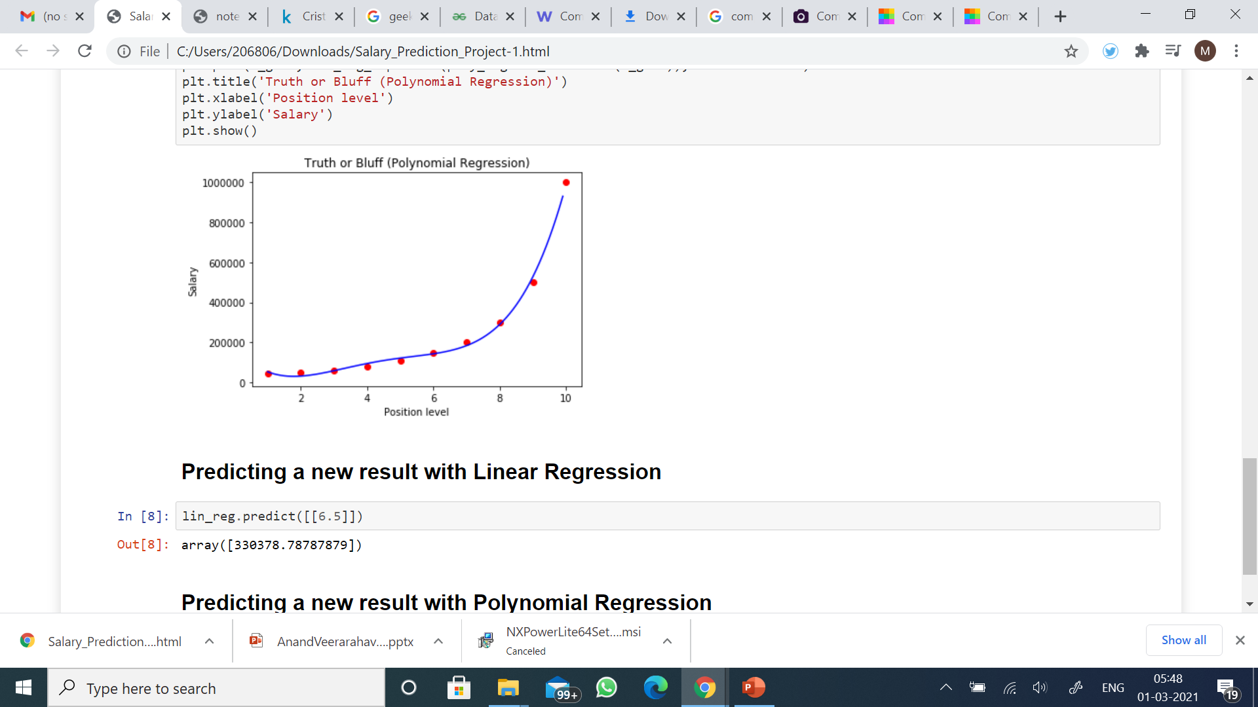
Visualizing the result for Polynomial Regression
Here we will visualize the result of Polynomial regression model, code for which is little different from the above model.
Code
mtp.scatter(x,y,color="blue")
mtp.plot(x, lin_reg_2.predict(poly_regs.fit_transform(x)), color="red")
mtp.title("Bluff detection model(Polynomial Regression)")
mtp.xlabel("Position Levels")
mtp.ylabel("Salary")
mtp.show()
In the above code, we have taken lin_reg_2.predict(poly_regs.fit_transform(x), instead of x_poly, because we want a Linear regressor object to predict the polynomial features matrix.

Slide 19

Predicting the final result with the Linear Regression model:
Now, we will predict the final output using the Linear regression model to see whether an employee is saying truth or bluff. So, for this, we will use the predict() method and will pass the value 6.5.
Code:
lin_pred = lin_regs.predict([[6.5]])
print(lin_pred)
Output:
[330378.78787879]

Slide 20

Predicting the final result with the Polynomial Regression model:
Now, we will predict the final output using the Polynomial Regression model to compare with Linear model. Below is the code for it:
poly_pred = lin_reg_2.predict(poly_regs.fit_transform([[6.5]]))
print(poly_pred)
Output:
[158862.45265153]
As we can see, the predicted output for the Polynomial Regression is [158862.45265153], which is much closer to real value hence, we can say that future employee is telling the truth.

Slide 21
References & Dataset
https://www.kaggle.com/akram24/position-salaries
https://www.w3schools.com/python/python_ml_polynomial_regression.asp

Slide 22

PROJECT – II PLAYER CAREER COMPARISON
AUTHOR : ANAND VEERARAHAVAN

Slide 23

OBJECTIVES
TO UNDERSTAND THE DATASET
TO DETERMINE ALL AVENUES TO EXPLORE DATA
TO CATEGORIZE SIMILAR AND DISTINGUISH UNIQUE FACTORS
TO PERFORM COMPARE AND CONTRAST BETWEEN THE PLAYERS ACROSS DIFFERENT AVENUES OF DATA
TO FIND CORRELATION BETWEEN DIFFERENT DATA COLUMNS
TO VISUALIZE DATA THROUGH EXPLORATORY ANALYSIS
This Photo by Unknown Author is licensed under CC BY

Slide 24

STEPS
IMPORT LIBRARIES
READ DATA
TAKE CARE OF MISSING DATA
INTERPRET NUMBER OF GOALS SCORED
YEAR WISE COMPARISON
VENUE WISE COMPARISON
TIME WISE COMPARISON
ASSISTED VS SOLO GOAL SCOREDCOMPARISON
POSITION WISE COMPARISON
GOAL TYPE WISE COMPARISON
NUMBER OF ASSISTS COMPARISON
OPPONENT WISE COMPARISON
This Photo by Unknown Author is licensed under CC BY-NC

Slide 25
IMPORTING LIBRARIES
The first step of the data preprocessing is to import the libraries.
To work with arrays , to perform numerical operations and to plot graphs we need to import libraries.
The OS module in Python provides functions for interacting with the operating system. OS comes under Python's standard utility modules. This module provides a portable way of using operating system-dependent functionality.
NumPy is a Python library used for working with arrays. It also has functions for working in domain of linear algebra, Fourier transform, and matrices.
Pandas is a software library written for the Python programming language for data manipulation and analysis. In particular, it offers data structures and operations for manipulating numerical tables and time series.
Matplotlib is a comprehensive library for creating static, animated, and interactive visualizations in Python.
Seaborn is a library that uses Matplotlib underneath to plot graphs. It will be used to visualize random distributions.

Slide 26
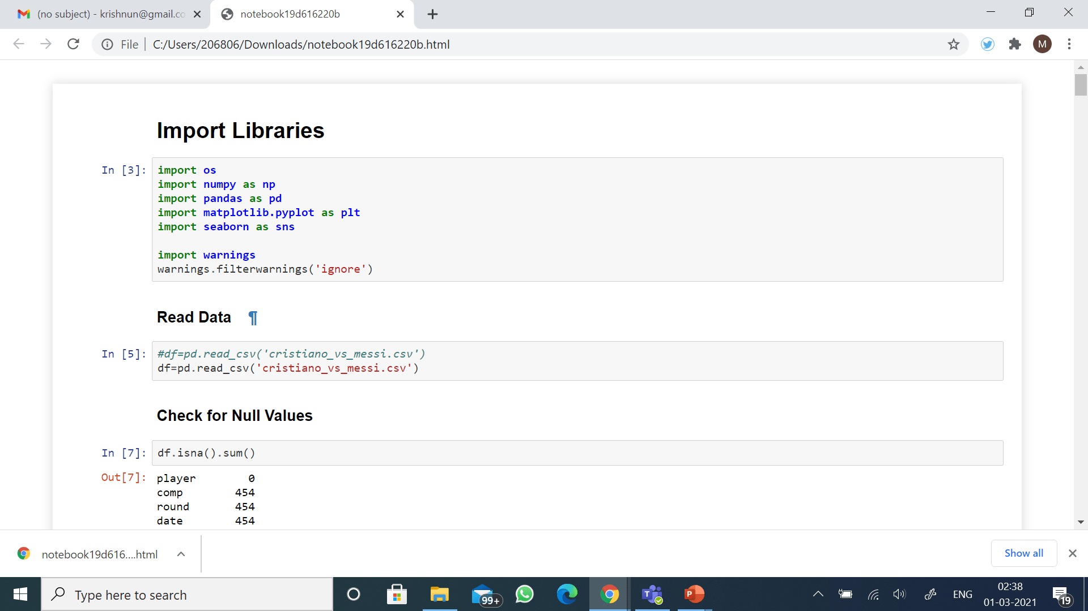
Import Libraries

Slide 27
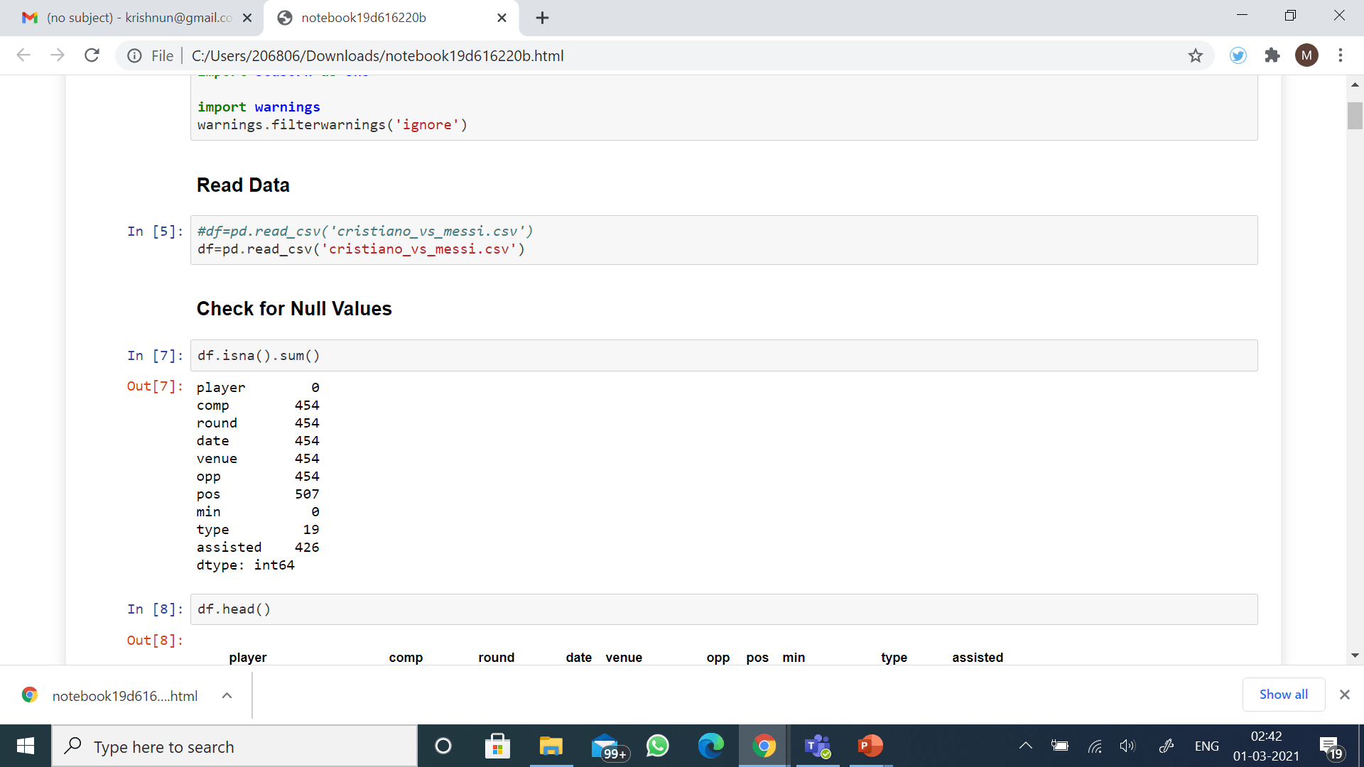
READ DATA

Slide 28
CHECK FOR NULL VALUES

Slide 29
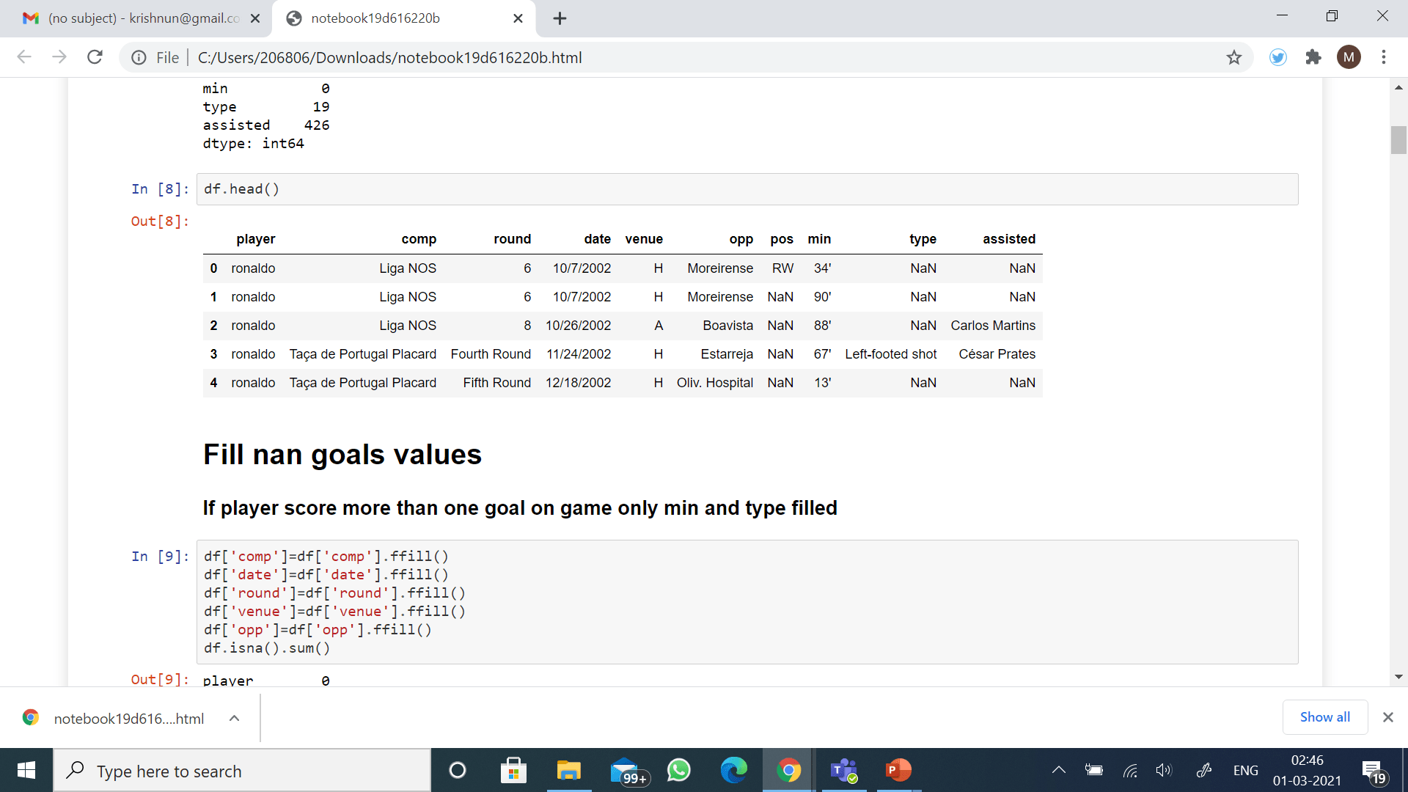
DISPLAY DATA

Slide 30
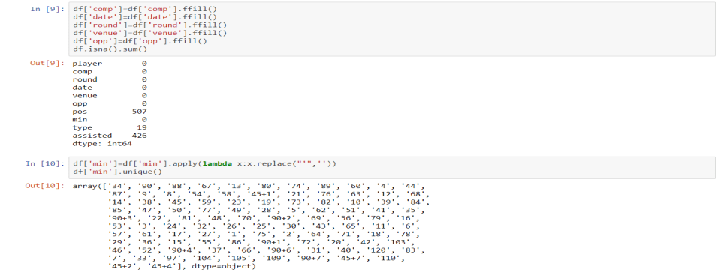
FILL NAN VALUES CODE AND CATEGORIZE DATA PART - I

Slide 31
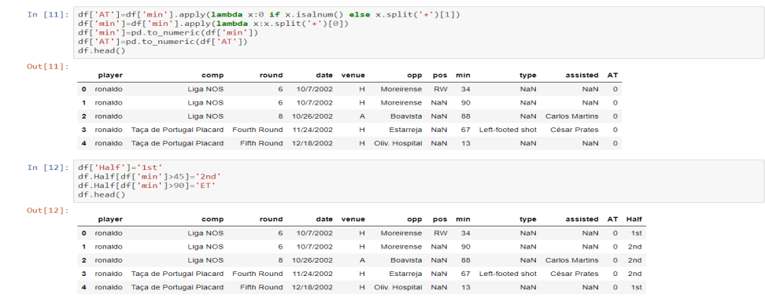
FILL NAN VALUES CODE AND CATEGORIZE DATA PART - II

Slide 32
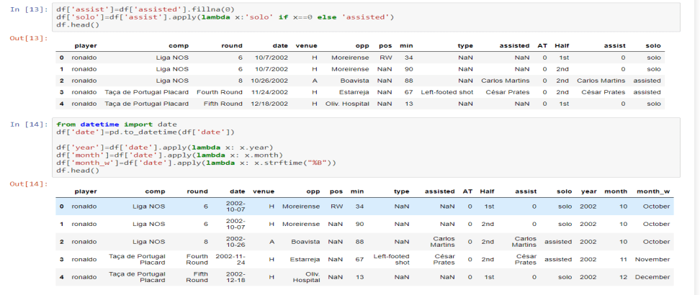
FILL NAN VALUES CODE AND CATEGORIZE DATA PART - III

Slide 33
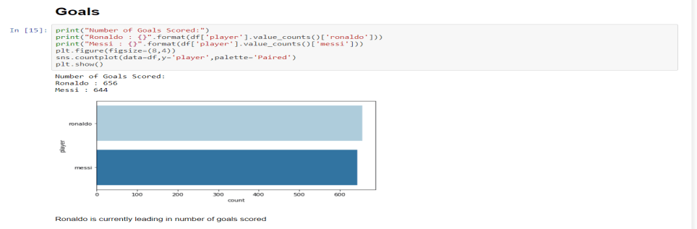
OVERALL NUMBER OF GOALS SCORED COMPARISON RONALDO(656) VS MESSI(644) RONALDO WINS
RONALDO LEADS MESSI BY 8 GOALS
RONALDO – 656
MESSI – 644

Slide 34
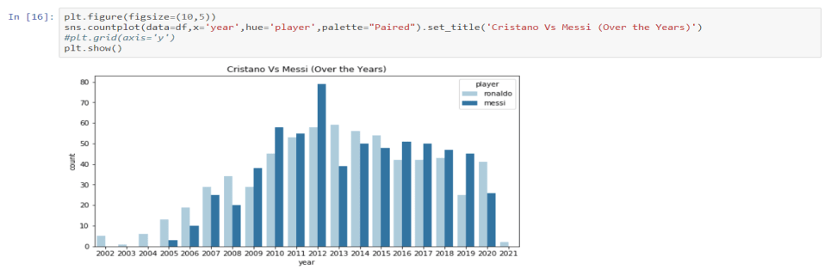
COMPARISON OF GOALS SCORED OVER THE YEARS RONALDO VS MESSI
RONALDO WINS (2002-2008) (2013-2015) (2020-2021)
MESSI WINS (2009-2012) (2016-2019)
OVERALL : RONALDO HAS BEATEN MESSI BY STAYING AHEAD IN MORE NUMBER OF YEARS

Slide 35
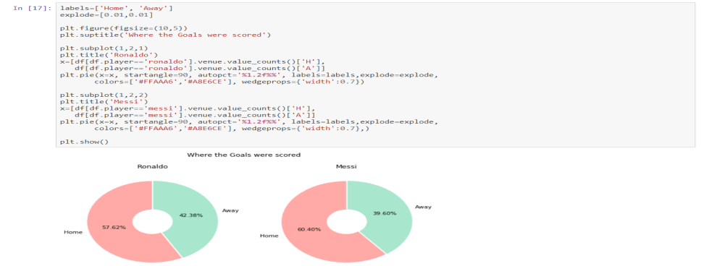
HOME VS AWAY GAMES PERFOMANCE
Ronaldo has scored more goals than Messi away from home, confirming his claim that he derives motivation from the opposite team's fans booing him.

Slide 36
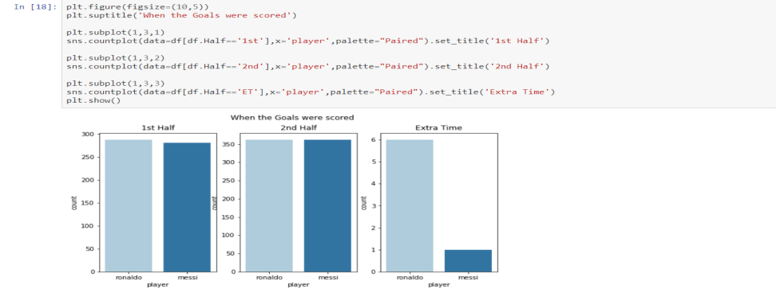
FIRST HALF VS SECOND HALF VS EXTRA TIME COMPARISON
RONALDO SCORES MORE THAN MESSI IN FIRST HALF.
RONALDO AND MESSI SCORE SAME NUMBER OF GOALS IN THE SECOND HALF
RONALDO SCORES MORE GOALS THAT MESSI IN EXTRA TIME.
Ronaldo has scored more goals than Messi away from home, confirming his claim that he derives motivation from the opposite team's fans booing him.

Slide 37
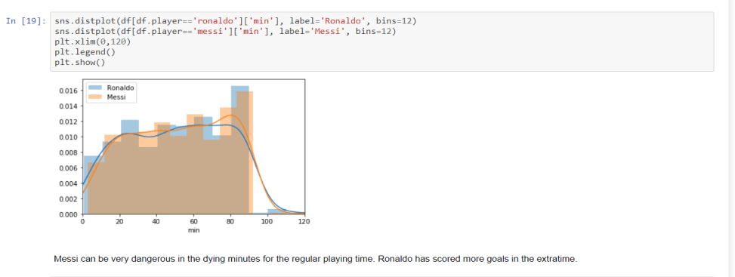
DYING MINUTES GOAL SCORING PLAYER
RONALDO SCORES MORE THAN MESSI IN FIRST HALF
RONALDO AND MESSI SCORE SAME AMOUNT OF GOALS IN THE SECOND HALF
RONALDO SCORES MORE GOALS THAT MESSI IN EXTRA TIME
Ronaldo has scored more goals than Messi away from home, confirming his claim that he derives motivation from the opposite team's fans booing him.

Slide 38
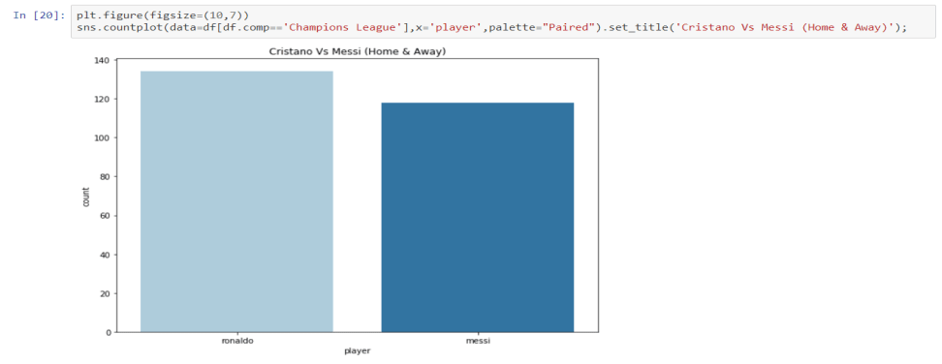
CHAMPIONS LEAGUE (HOME VS AWAY)
RONALDO HAS MORE GOALS(HOME AND AWAY) THAN MESSI IN CHAMPIONS LEAGUE.
RONALDO SCORES MORE THAN MESSI IN FIRST HALF
RONALDO AND MESSI SCORE SAME AMOUNT OF GOALS IN THE SECOND HALF
RONALDO SCORES MORE GOALS THAT MESSI IN EXTRA TIME
Ronaldo has scored more goals than Messi away from home, confirming his claim that he derives motivation from the opposite team's fans booing him.

Slide 39
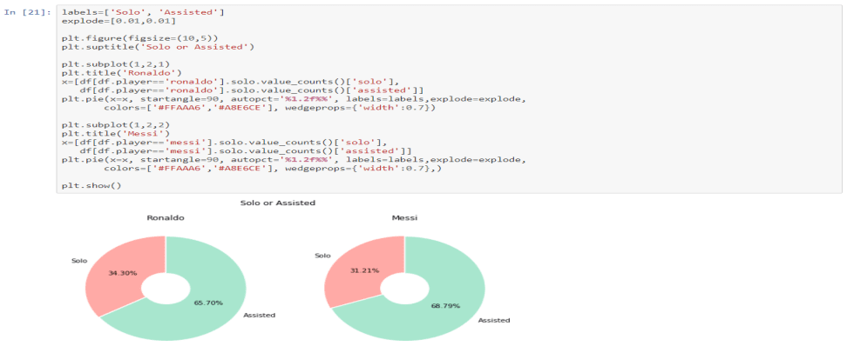
GOALS SCORED ON ASSISTS VS SOLO
RONALDO HAS MORE GOALS(HOME AND AWAY) THAN MESSI IN CHAMPIONS LEAGUE.
RONALDO SCORES MORE THAN MESSI IN FIRST HALF
RONALDO AND MESSI SCORE SAME AMOUNT OF GOALS IN THE SECOND HALF
RONALDO SCORES MORE GOALS THAT MESSI IN EXTRA TIME
MESSI SCORES MORE GOAL WHEN ASSISTED THAN RONALDO SCORES WHEN HE IS ASSISTED.
RONALDO SCORES MORE SOLO GOALS THAN MESSI.
Ronaldo has scored more goals than Messi away from home, confirming his claim that he derives motivation from the opposite team's fans booing him.

Slide 40
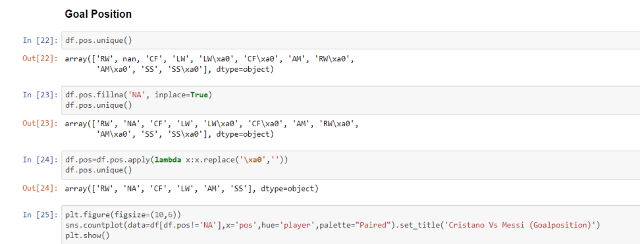
GOALS POSITION ANALYSIS PART - I
RONALDO HAS MORE GOALS(HOME AND AWAY) THAN MESSI IN CHAMPIONS LEAGUE.
RONALDO SCORES MORE THAN MESSI IN FIRST HALF
RONALDO AND MESSI SCORE SAME AMOUNT OF GOALS IN THE SECOND HALF
RONALDO SCORES MORE GOALS THAT MESSI IN EXTRA TIME
MESSI SCORES MORE GOAL WHEN ASSISTED THAN RONALDO SCORES WHEN HE IS ASSISTED.
RONALDO SCORES MORE SOLO GOALS THAN MESSI.
Ronaldo has scored more goals than Messi away from home, confirming his claim that he derives motivation from the opposite team's fans booing him.

Slide 41
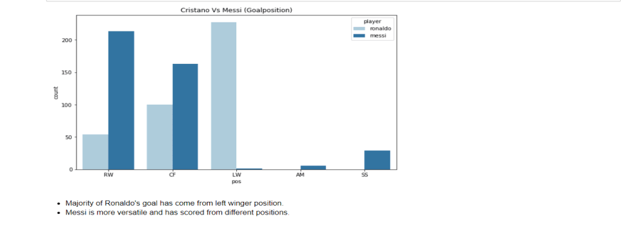
GOALS POSITION ANALYSIS PART - II
RONALDO HAS MORE GOALS(HOME AND AWAY) THAN MESSI IN CHAMPIONS LEAGUE.
RONALDO SCORES MORE THAN MESSI IN FIRST HALF
RONALDO AND MESSI SCORE SAME AMOUNT OF GOALS IN THE SECOND HALF
RONALDO SCORES MORE GOALS THAT MESSI IN EXTRA TIME
MESSI SCORES MORE GOAL WHEN ASSISTED THAN RONALDO SCORES WHEN HE IS ASSISTED.
RONALDO SCORES MORE SOLO GOALS THAN MESSI.
Ronaldo has scored more goals than Messi away from home, confirming his claim that he derives motivation from the opposite team's fans booing him.

Slide 42
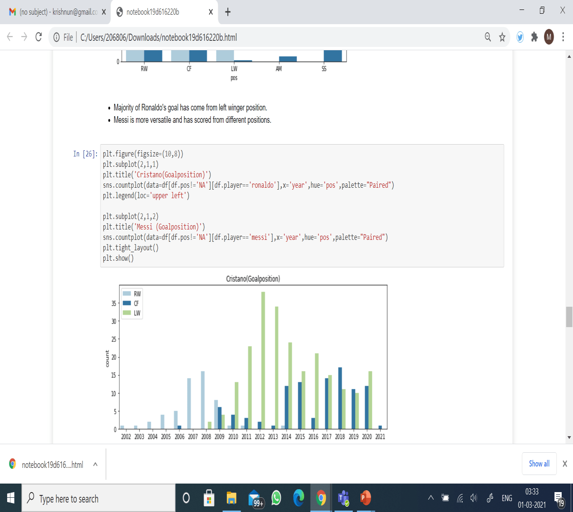
GOALS POSITION ANALYSIS PART - III
RONALDO HAS MORE GOALS(HOME AND AWAY) THAN MESSI IN CHAMPIONS LEAGUE.
RONALDO SCORES MORE THAN MESSI IN FIRST HALF
RONALDO AND MESSI SCORE SAME AMOUNT OF GOALS IN THE SECOND HALF
RONALDO SCORES MORE GOALS THAT MESSI IN EXTRA TIME
MESSI SCORES MORE GOAL WHEN ASSISTED THAN RONALDO SCORES WHEN HE IS ASSISTED.
RONALDO SCORES MORE SOLO GOALS THAN MESSI.
Ronaldo has scored more goals than Messi away from home, confirming his claim that he derives motivation from the opposite team's fans booing him.

Slide 43
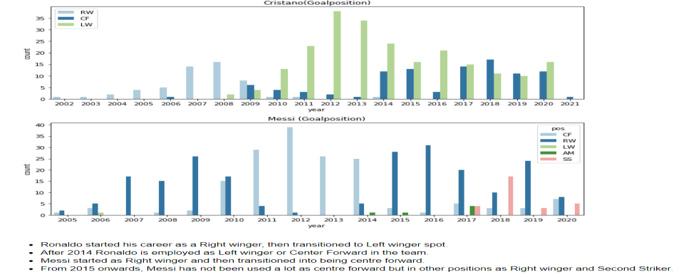
GOALS POSITION ANALYSIS PART - IV
RONALDO HAS MORE GOALS(HOME AND AWAY) THAN MESSI IN CHAMPIONS LEAGUE.
RONALDO SCORES MORE THAN MESSI IN FIRST HALF
RONALDO AND MESSI SCORE SAME AMOUNT OF GOALS IN THE SECOND HALF
RONALDO SCORES MORE GOALS THAT MESSI IN EXTRA TIME
MESSI SCORES MORE GOAL WHEN ASSISTED THAN RONALDO SCORES WHEN HE IS ASSISTED.
RONALDO SCORES MORE SOLO GOALS THAN MESSI.
Ronaldo has scored more goals than Messi away from home, confirming his claim that he derives motivation from the opposite team's fans booing him.

Slide 44
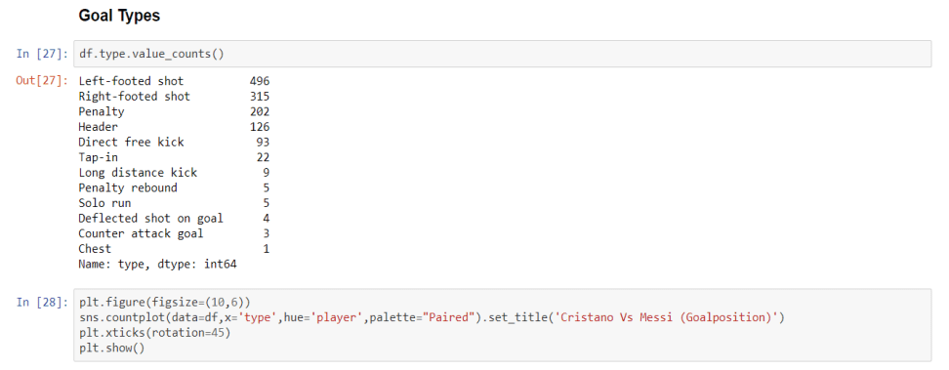
GOALS TYPES ANALYSIS PART - I
RONALDO HAS MORE GOALS(HOME AND AWAY) THAN MESSI IN CHAMPIONS LEAGUE.
RONALDO SCORES MORE THAN MESSI IN FIRST HALF
RONALDO AND MESSI SCORE SAME AMOUNT OF GOALS IN THE SECOND HALF
RONALDO SCORES MORE GOALS THAT MESSI IN EXTRA TIME
MESSI SCORES MORE GOAL WHEN ASSISTED THAN RONALDO SCORES WHEN HE IS ASSISTED.
RONALDO SCORES MORE SOLO GOALS THAN MESSI.
Ronaldo has scored more goals than Messi away from home, confirming his claim that he derives motivation from the opposite team's fans booing him.

Slide 45
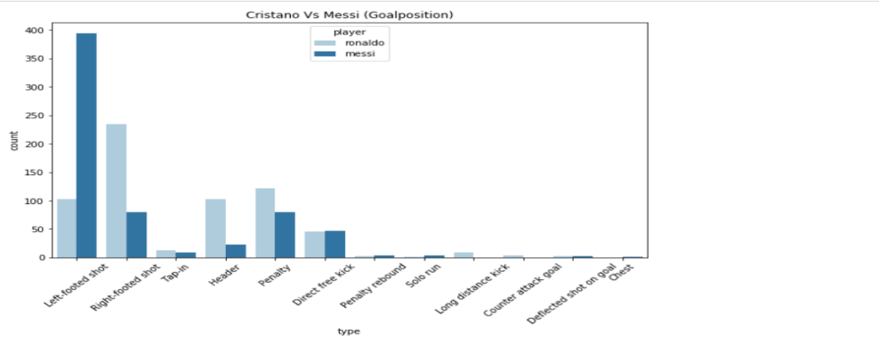
GOALS TYPES ANALYSIS PART - II
MESSI HAS THE MOST NUMBER OF LEFT FOOT SHOTS
RONALDO HAS THE MOST NUMBER OF RIGHT FOOT SHOTS
RONALDO LEADS IN TAP-IN, HEADER, PENALTY, LONG DISTANCE KICK KIND OF GOALS.
MESSI LEADS IN DIRECT FREE KICK, PENALTY REBOUNDS, SOLO RUN, DEFLECTION SHOTS AND CHEST SHOT KIND OF GOALS
RONALDO HAS MORE GOALS(HOME AND AWAY) THAN MESSI IN CHAMPIONS LEAGUE.
RONALDO SCORES MORE THAN MESSI IN FIRST HALF
RONALDO AND MESSI SCORE SAME AMOUNT OF GOALS IN THE SECOND HALF
RONALDO SCORES MORE GOALS THAT MESSI IN EXTRA TIME
MESSI SCORES MORE GOAL WHEN ASSISTED THAN RONALDO SCORES WHEN HE IS ASSISTED.
RONALDO SCORES MORE SOLO GOALS THAN MESSI.
Ronaldo has scored more goals than Messi away from home, confirming his claim that he derives motivation from the opposite team's fans booing him.

Slide 46
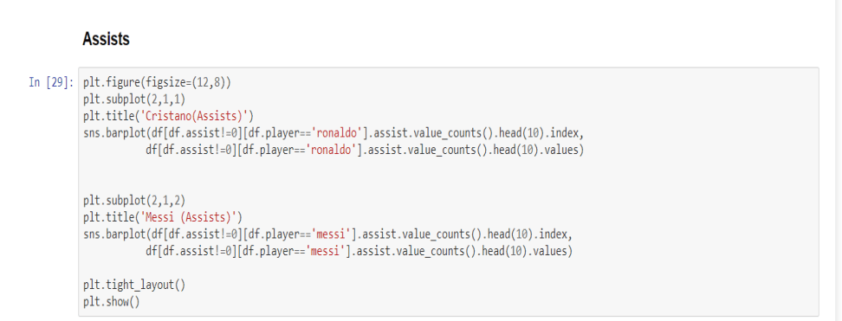
ASSIST PLAYER COMPARISON PART - I
MESSI HAS THE MOST NUMBER OF LEFT FOOT SHOTS
RONALOD HAS THE MOST NUMBER OF RIGHT FOOT SHOTS
RONALDO LEADS IN TAP-IN, HEADER, PENALTY, LONG DISTANCE KICK KIND OF GOALS.
MESSI LEADS IN DIRECT FREE KICK, PENALTY REBOUNDS, SOLO RUN, DEFLECTION SHOTS AND CHEST SHOT KIND OF GOALS
RONALDO HAS MORE GOALS(HOME AND AWAY) THAN MESSI IN CHAMPIONS LEAGUE.
RONALDO SCORES MORE THAN MESSI IN FIRST HALF
RONALDO AND MESSI SCORE SAME AMOUNT OF GOALS IN THE SECOND HALF
RONALDO SCORES MORE GOALS THAT MESSI IN EXTRA TIME
MESSI SCORES MORE GOAL WHEN ASSISTED THAN RONALDO SCORES WHEN HE IS ASSISTED.
RONALDO SCORES MORE SOLO GOALS THAN MESSI.
Ronaldo has scored more goals than Messi away from home, confirming his claim that he derives motivation from the opposite team's fans booing him.

Slide 47
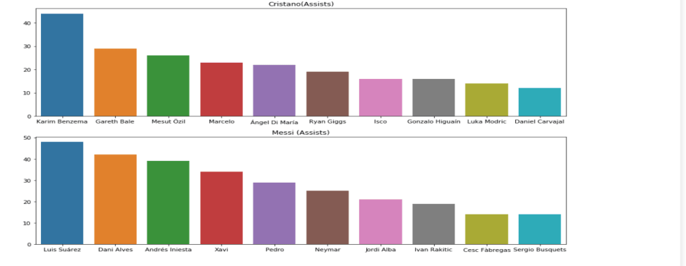
ASSIST PLAYER COMPARISON PART - II
MESSI HAS THE MOST NUMBER OF LEFT FOOT SHOTS
RONALOD HAS THE MOST NUMBER OF RIGHT FOOT SHOTS
RONALDO LEADS IN TAP-IN, HEADER, PENALTY, LONG DISTANCE KICK KIND OF GOALS.
MESSI LEADS IN DIRECT FREE KICK, PENALTY REBOUNDS, SOLO RUN, DEFLECTION SHOTS AND CHEST SHOT KIND OF GOALS
KARIM BENZEMA IS THE LEADING ASSIST MAKER FOR RONALDO
LUIS SUARAZ IS THE LEADING ASSIST MAKER FOR MESSI
DANIEL CARVAJAL IS THE LEAST ASSIST MAKER FOR RONALDO
SERGIO BUSQUETS IS THE LEAST ASSIST MAKER FOR MESSI
RONALDO HAS MORE GOALS(HOME AND AWAY) THAN MESSI IN CHAMPIONS LEAGUE.
RONALDO SCORES MORE THAN MESSI IN FIRST HALF
RONALDO AND MESSI SCORE SAME AMOUNT OF GOALS IN THE SECOND HALF
RONALDO SCORES MORE GOALS THAT MESSI IN EXTRA TIME
MESSI SCORES MORE GOAL WHEN ASSISTED THAN RONALDO SCORES WHEN HE IS ASSISTED.
RONALDO SCORES MORE SOLO GOALS THAN MESSI.
Ronaldo has scored more goals than Messi away from home, confirming his claim that he derives motivation from the opposite team's fans booing him.

Slide 48
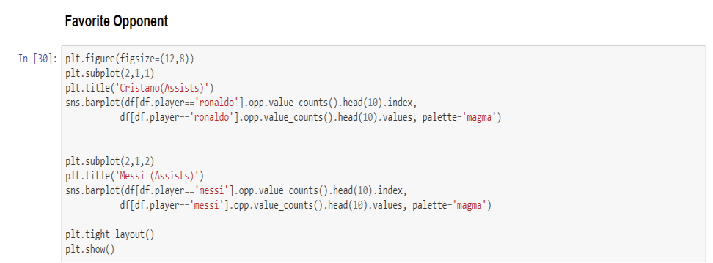
FAVOURITE OPPONENT PART - I
KARIM BENZEMA IS THE LEADING ASSIST MAKER FOR RONALDO
LUIS SUARAZ IS THE LEADING ASSIST MAKER FOR MESSI
DANIEL CARVAJAL IS THE LEAST ASSIST MAKER FOR RONALDO
SERGIO BUSQUETS IS THE LEAST ASSIST MAKER FOR MESSI
RONALDO HAS MORE GOALS(HOME AND AWAY) THAN MESSI IN CHAMPIONS LEAGUE.
RONALDO SCORES MORE THAN MESSI IN FIRST HALF
RONALDO AND MESSI SCORE SAME AMOUNT OF GOALS IN THE SECOND HALF
RONALDO SCORES MORE GOALS THAT MESSI IN EXTRA TIME
MESSI SCORES MORE GOAL WHEN ASSISTED THAN RONALDO SCORES WHEN HE IS ASSISTED.
RONALDO SCORES MORE SOLO GOALS THAN MESSI.
Ronaldo has scored more goals than Messi away from home, confirming his claim that he derives motivation from the opposite team's fans booing him.

Slide 49
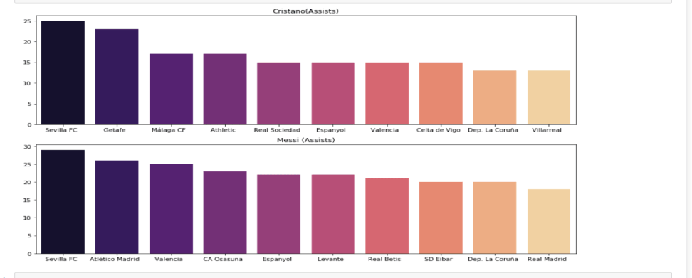
FAVOURITE OPPONENT PART - II
MESSI HAS THE MOST NUMBER OF LEFT FOOT SHOTS
RONALOD HAS THE MOST NUMBER OF RIGHT FOOT SHOTS
RONALDO LEADS IN TAP-IN, HEADER, PENALTY, LONG DISTANCE KICK KIND OF GOALS.
MESSI LEADS IN DIRECT FREE KICK, PENALTY REBOUNDS, SOLO RUN, DEFLECTION SHOTS AND CHEST SHOT KIND OF GOALS
RONALDO’S AND MESSI HAVE THE SAME FAVORITE OPPONENT IN TERMS OF GOAL SCORING, WHICH IS SEVILLA FC.
KARIM BENZEMA IS THE LEADING ASSIST MAKER FOR RONALDO
LUIS SUARAZ IS THE LEADING ASSIST MAKER FOR MESSI
DANIEL CARVAJAL IS THE LEAST ASSIST MAKER FOR RONALDO
SERGIO BUSQUETS IS THE LEAST ASSIST MAKER FOR MESSI
RONALDO HAS MORE GOALS(HOME AND AWAY) THAN MESSI IN CHAMPIONS LEAGUE.
RONALDO SCORES MORE THAN MESSI IN FIRST HALF
RONALDO AND MESSI SCORE SAME AMOUNT OF GOALS IN THE SECOND HALF
RONALDO SCORES MORE GOALS THAT MESSI IN EXTRA TIME
MESSI SCORES MORE GOAL WHEN ASSISTED THAN RONALDO SCORES WHEN HE IS ASSISTED.
RONALDO SCORES MORE SOLO GOALS THAN MESSI.
Ronaldo has scored more goals than Messi away from home, confirming his claim that he derives motivation from the opposite team's fans booing him.

Slide 50

REFERENCES AND DATASETS
https://www.kaggle.com/cristiano-ronaldo-vs-lionel-messi-goals-eda
https://www.geeksforgeeks.org/data-analysis-visualization-python

Slide 51



